Slide 1


Waterborne Disease Prediction Report
DataVerse
Africa
PRESENTED BY : DA - 14

Slide 2

Problem Statement
Waterborne diseases remain a significant public health concern, especially in underserved communities.
This project aims to predict total waterborne disease cases and assess community risk levels based on water quality indicators.

Slide 3
Data Collection & Preparation
Dataset: 10,400 records, including water quality indicators and disease case counts.
Columns: Date, Month, Region, Region Code, Community, Country, Turbidity(NTU), E. coli Count(CFU/100ml), Nitrate(mg/L), pH, Cholera Cases, Typhoid Cases, Diarrhea Cases.
Missing Dates & Months: 41 missing values each, handled using forward-fill after sorting by date.
Engineered Features:
i. Country: Added based on community research.
ii. Total Waterborne Cases = Cholera + Typhoid + Diarrhea.
iii. Risk Level: High (≥10), Medium (5–9), Low (<5).

Slide 4
Outlier Analysis
Initial features included: Turbidity, E. coli Count, Nitrate, pH, Cholera Cases, Typhoid Cases, Diarrhea Cases.
Strong multicollinearity was found: Total Waterborne Cases was a perfect sum of Cholera, Typhoid, and Diarrhea cases.
To avoid data leakage, disease case columns were removed from predictors, leaving only water quality features.

Slide 5
Model Insights
Health Impact on Waterborne Cases across African Communities.
Spatial Risk Level across African Communities.
Correlation Heat Map.

Slide 6
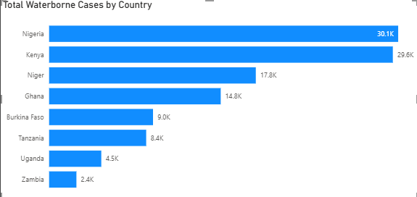
Health Impact on Waterborne Cases across African Communities
Total waterborne cases were reported to be highest in Nigeria, representing approximately 27% of total cases.

Slide 7
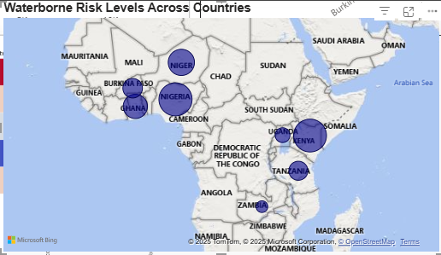
Spatial Risk Level across African Communities
Nigeria and Kenya were reported to have more high-risk cases than the other countries.

Slide 8
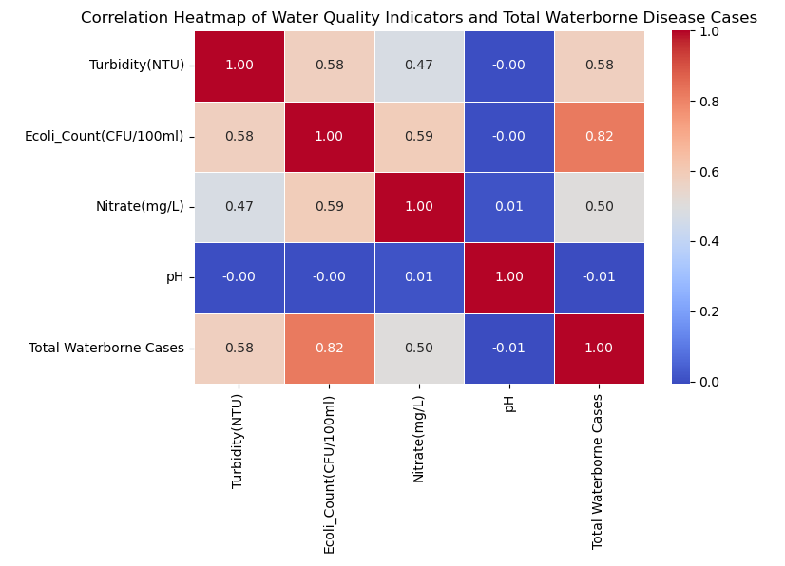
Correlation Heat Map
The E coli count was the most significant predictor of the disease cases, with a correlation coefficient of 0.82, implying a strong positive correlation.
On the other hand, the pH was seen to have a weak and negative relationship with the disease cases, with a correlation coefficient of -0.01

Slide 9
Modeling Approach
Regression (Primary Task):
Target: Total Waterborne Cases
Models:
• Linear Regression (baseline)
• Random Forest Regressor
• XGBoost Regressor
• LSTM (optional time series enhancement)
Classification (Secondary Task):
Target: Risk Level
Models:
• Logistic Regression
• Random Forest Classifier
• XGBoost Classifier

Slide 10
Regression Results
Linear Regression: MSE=10.99, R²=0.694
Random Forest: MSE=12.41, R²=0.655
XGBoost: MSE=11.73, R²=0.674
LSTM: MSE=17836.80, R²=0.674

Slide 11
Classification Results
Logistic Regression:
Accuracy=0.78, Macro F1=0.72, Weighted F1=0.77
Random Forest Classifier:
Accuracy=0.76, Macro F1=0.72
Precision: High=0.83, Low=0.75, Medium=0.56
XGBoost Classifier:
Accuracy=0.76, Macro F1=0.72
Precision: High=0.84, Low=0.76, Medium=0.56

Slide 12
Policy Recommendations
Invest in sensors and IoT solutions for continuous water quality tracking in high-risk communities.
Use the risk classification to prioritize vaccination, health education, and sanitation initiatives in vulnerable zones.
Promote hygiene and water treatment education, particularly in areas flagged as high-risk by the model.
Conduct regular water quality monitoring focusing on turbidity, E. coli, nitrate, and pH.
Launch awareness campaigns in high-risk areas.
Integrate predictive analytics into public health planning to allocate resources more effectively.

Slide 13
Impact of Data-Driven Insights on Waterborne Disease Control
Provide actionable guidance to NGOs, health ministries, and WASH (Water, Sanitation, and Hygiene) programs for strategic deployment of water sanitation units in vulnerable and at-risk communities.
Enable early prediction of disease outbreaks to reduce response times, allowing for timely intervention before situations escalate.
Support evidence-based budgeting and optimal resource allocation by leveraging data-driven insights, ensuring funds and efforts are directed where they are most needed.

Slide 14

THANK YOU FOR LISTENING

